Slide 1
PHYSICS (VOLUME TWO)
Electromagnetism
Optics
Modern Physics

Slide 2
Preview
Old Greeks knowledge about static-electrical attraction and the attraction between mineral magnetite since 600 B.C.
Force between charged matters by Coulomb In 1785
Electromagnetic induction—H.C. Oersted discovery in 1820
Development of electromagnetic theory by M. Faraday and J.C. Maxwell in the 19th century.

Slide 3
Preview
Relativity theory on Maxwell’s equation by A. Einstain in 1905
Quantum Electro-dynamics (QCD) by Dirac, Dyson , Feynman and others from 1928 to 1949
Unification of electromagnetic interaction with the weak interaction by S. Glashow, S. Weinberg and A. Salam in 1967
Unification of all the basic forces —gravitational force, electromagnetic force, weak force and strong force

Slide 4
Task in This Course
Fundamentals — classical theory of electromagnetism
Electrostatics
Magnetstatics
Lorentz Force Formula
Electromagnetic Induction and Faraday’s Law
Maxwell Equations

Slide 5
Physics II
Chapter 25 Electric Charge
and Coulomb’s Law

Slide 6
Electric Charge
Originally the names of two kinds of charges, negative and positive charges, were from Benjamin Franklin (1706-1790)
Matters consist of atoms, and atoms consist of nuclei and electrons, where electron has negative charge, and nucleus has positive charge.

Slide 7
Electric Charge
positive
negative

Slide 8
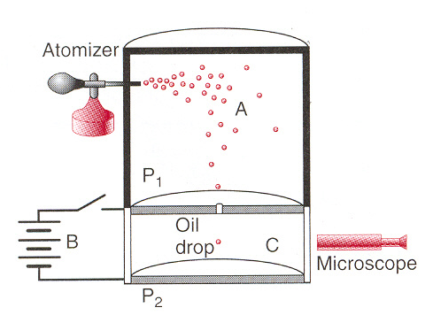
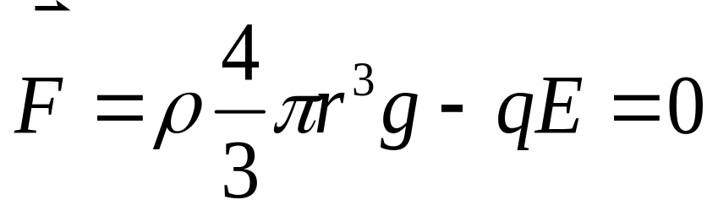
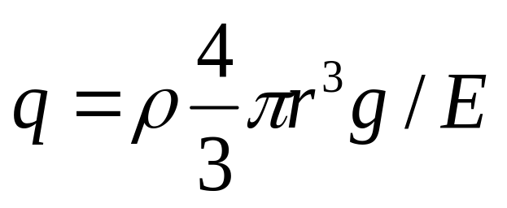
Charge Quantization
Measuring the elementary charge—Millikan oil-drop experiment
6.568x10⁻¹⁹ c 18.08x10⁻¹⁹ c
8.204x10⁻¹⁹ c 19.71x10⁻¹⁹ c
11.50x10⁻¹⁹ c 22.89x10⁻¹⁹ c
13.13x10⁻¹⁹ c 26.13x10⁻¹⁹ c
16.48x10⁻¹⁹ c
1.636x10⁻¹⁹ c 1.63x10⁻¹⁹ c
3.296x10⁻¹⁹ c 3.18x10⁻¹⁹ c
1.67x10⁻¹⁹ c 3.24x10⁻¹⁹ c
3.25x10⁻¹⁹ c 1.60x10⁻¹⁹ c
2x1.648x10⁻¹⁹ c
2x1.590x10⁻¹⁹ c
difference
2x1.620x10⁻¹⁹ c
2x1.625x10⁻¹⁹ c

Slide 9
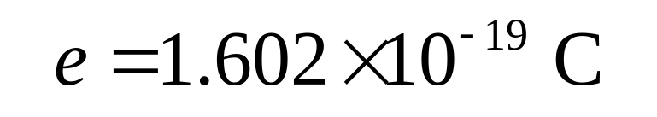

Charge Quantization
The charge q observed turns out to be the multiples of a certain elementary charge e,
where e is
Proton has a charge of 1e, while electron has a charge of -1e.
Macros objects are electrically neutral

Slide 10
Charge Conservation
In any physical process happened in a closed system, the algebraic sum of the total charges remains invariant.

Slide 11
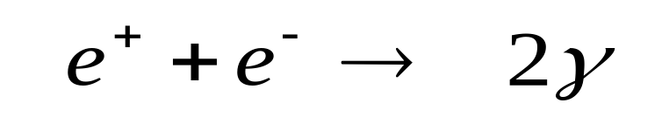
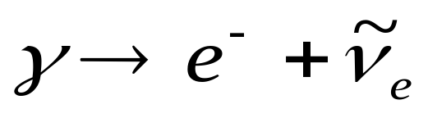
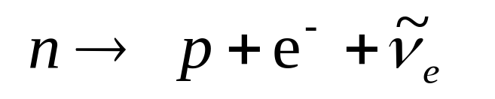
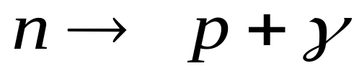
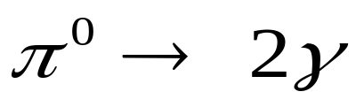
Charge Conservation
Examples:
However,
In any physical process happened in a closed system, the algebraic sum of the total charges remains invariant.

Slide 12
Conductors and Insulators
band
core level
solid
Conductor

Slide 13
Conductors and Insulators
Conductor
Insulator

Slide 14
Conductors and Insulators
Insulator

Slide 15
Conductors and Insulators
Insulator
Semiconductor

Slide 16
Conductors and Insulators
Glass
Copper

Slide 17
Conductors and Insulators
Glass
Copper

Slide 18
Conductors and Insulators
Glass
Copper

Slide 19
Conductors and Insulators
Copper

Slide 20


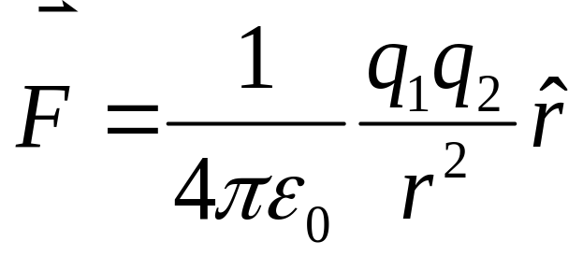
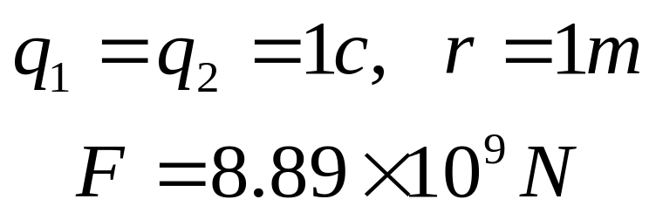
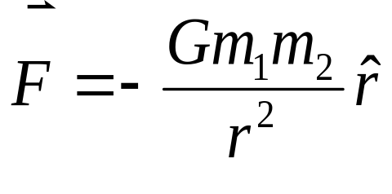
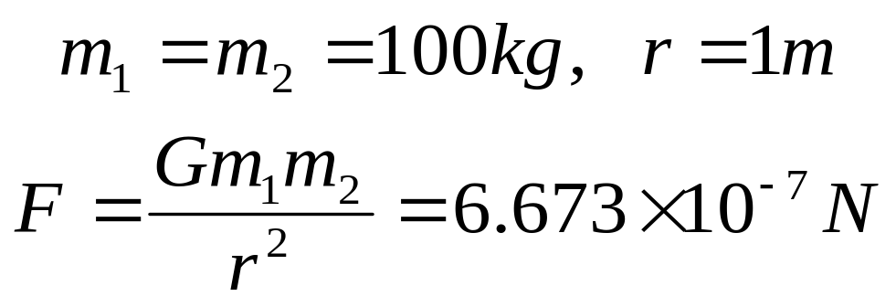
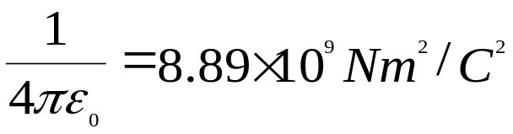

Coulomb’s Law
Coulomb Force:
q₁
q₂

Slide 21
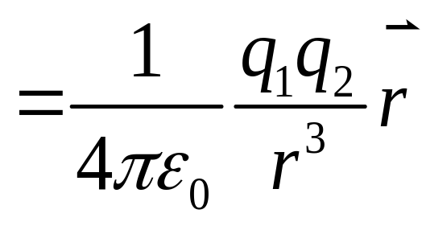
Coulomb’s Law
Coulomb Force:
q₁
q₂
Vector
Vector
Action—reaction pair
Vector
Action—reaction pair
satisfies the principle of superposition

Slide 22

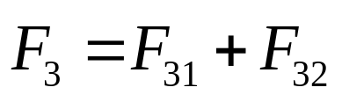
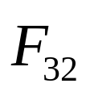
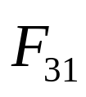
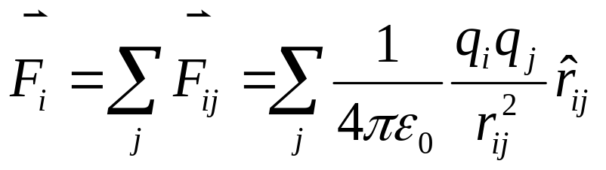
Principle of Superposition
Y
q₃
q₁
X
q₂

Slide 23
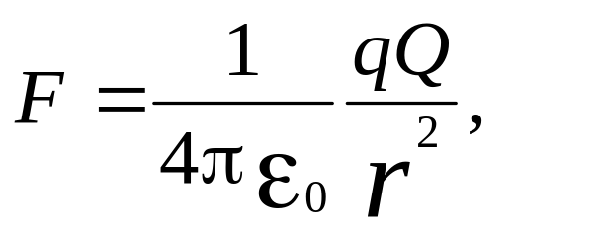
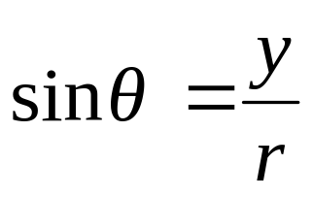
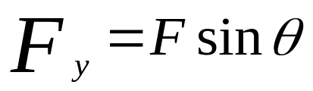
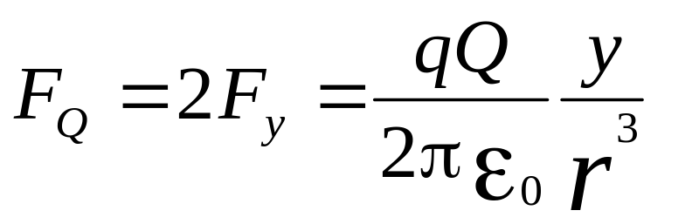
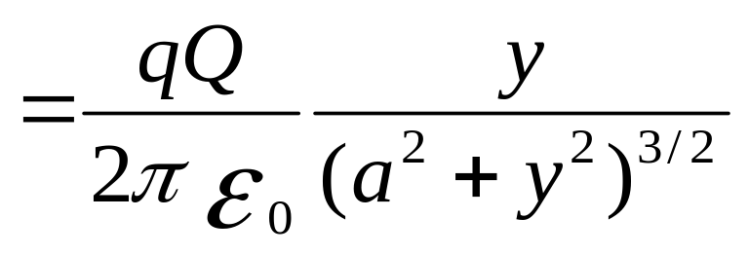
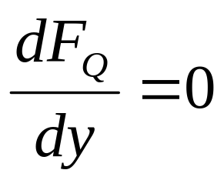
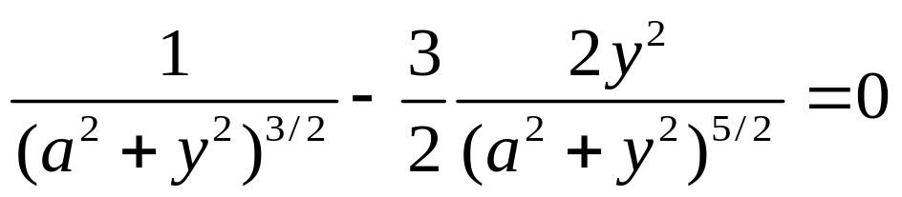
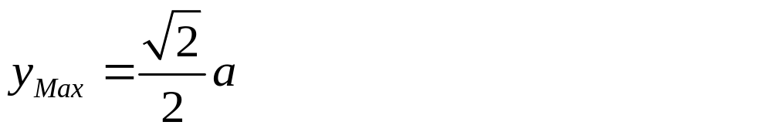
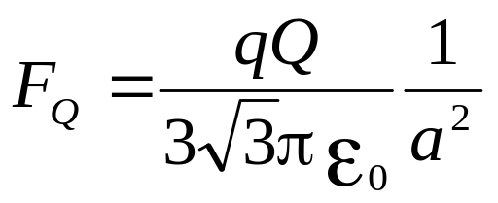
Example
y
F_{y}
F
As shown, three charges placed in a plane. Find y for which the force on the Q has a maximum value.
Q
F_{x}
q
y
q
θ
x
a
a

Slide 24
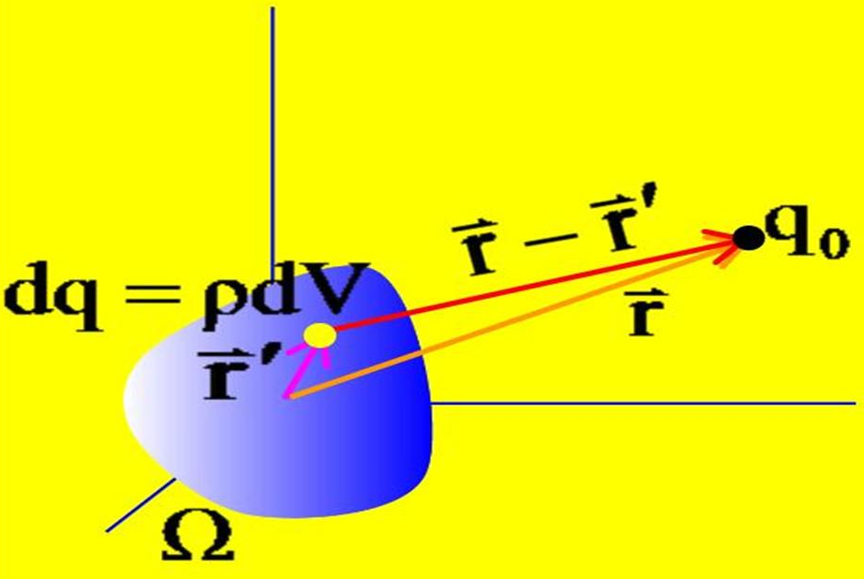
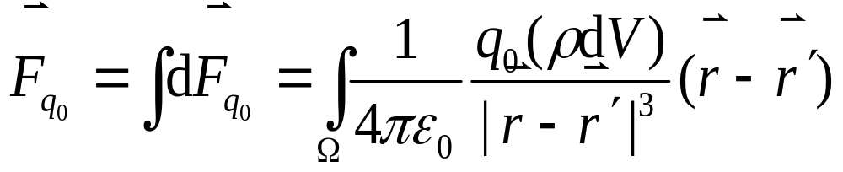

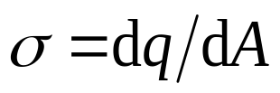
Continuous Charge
divide the charge into infinitesimal charged elements, regard each element as a point charge, and do superposition.
Linear Charge density λ :
Surface Charge Density σ:

Slide 25
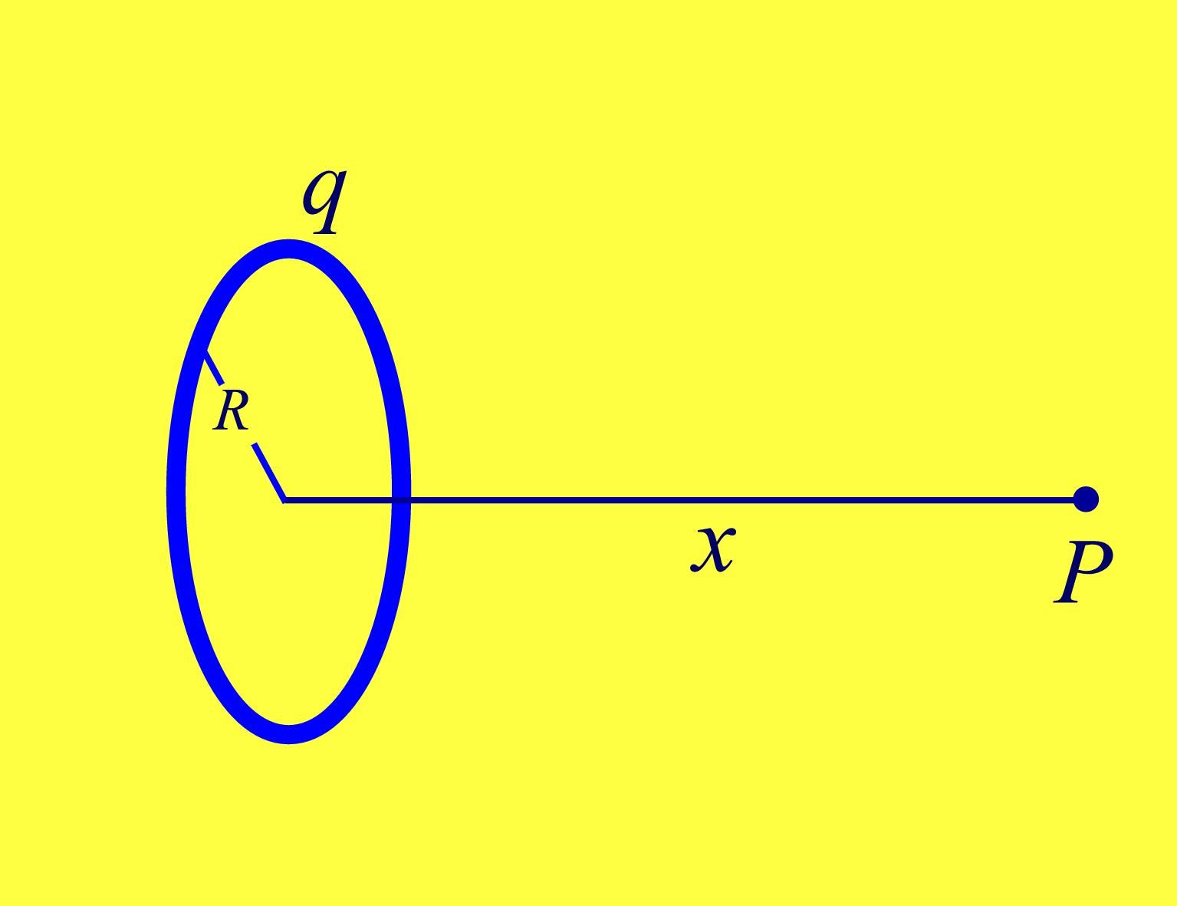








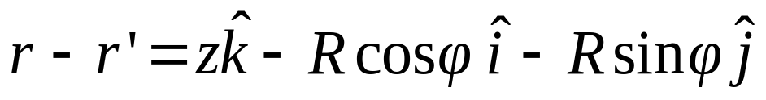

Example — a Ring
What is the Coulomb force acting on point charge q₀ at P by the uniformly charged ring ?
dq
The charge distribution:
The point charge of dq:

Slide 26
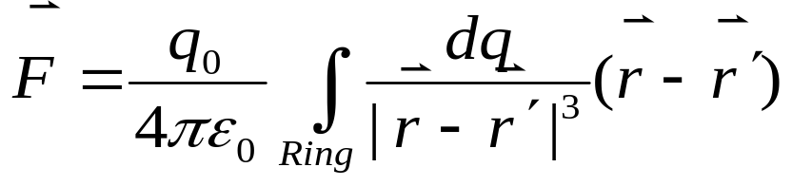
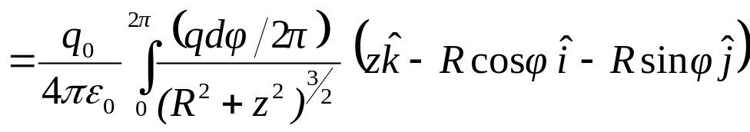
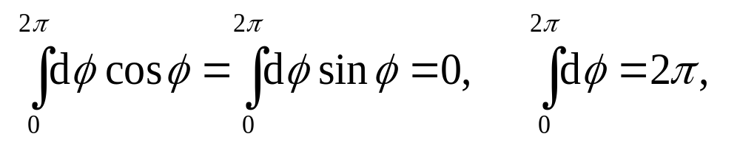
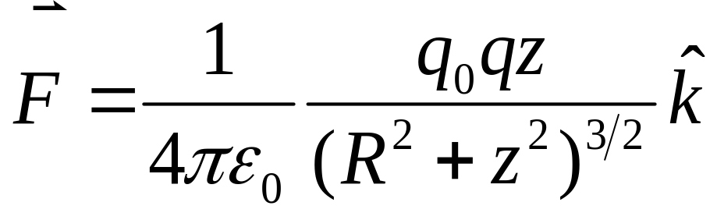
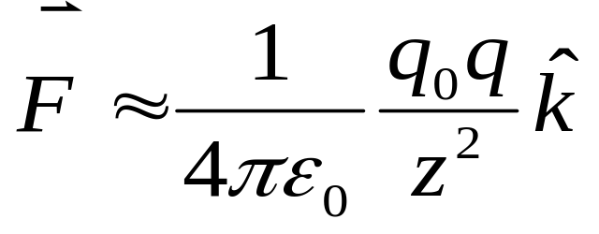
Example — a Ring
The force exerted on q₀:
dq
In case of z >> R,
The point charge of dq:

Slide 27

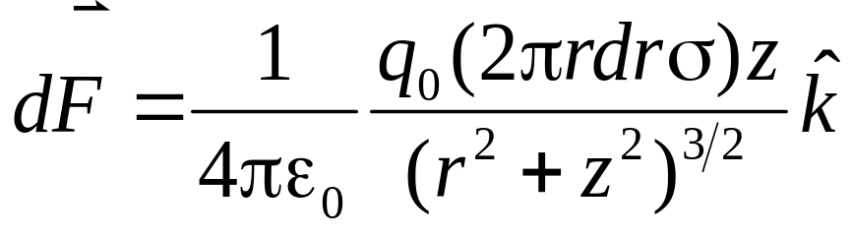

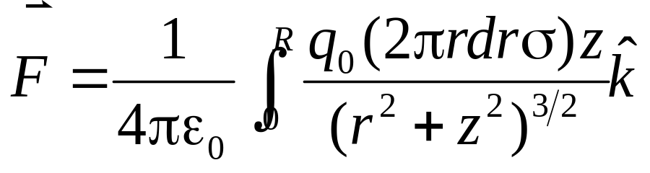
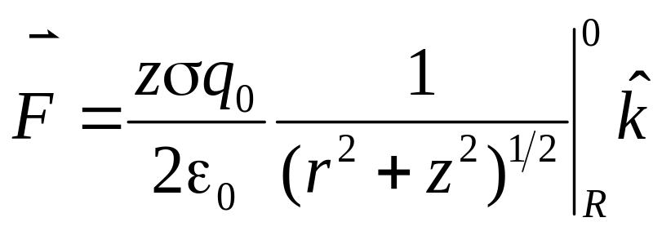
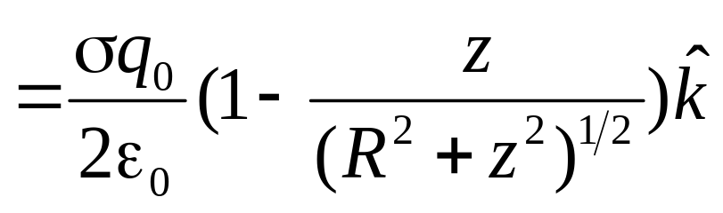
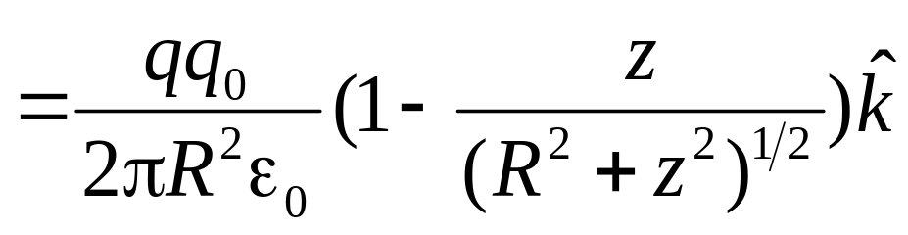
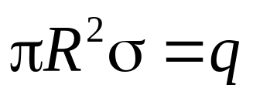
Example — a Disk

Slide 28

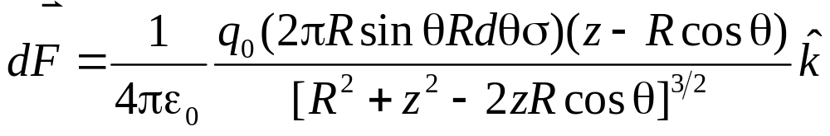
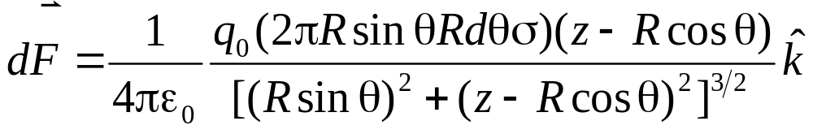

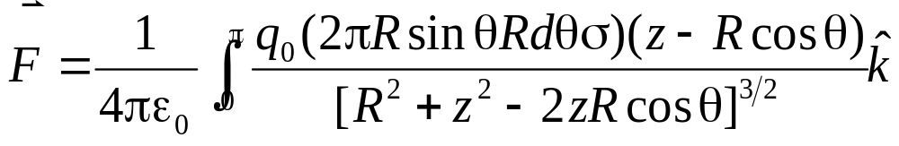
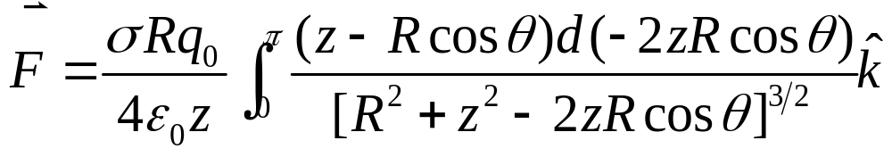
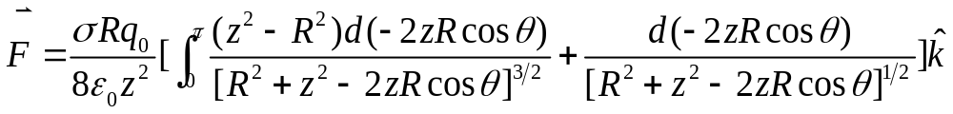
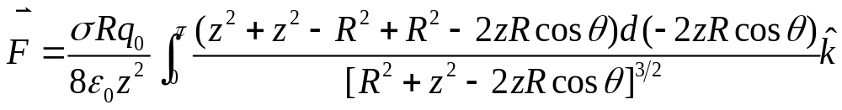

Example — a Spherical Thin shell

Slide 29





Example — a Spherical Thin shell

Slide 30



Example — a Spherical Thin shell

Slide 31












Slide 32




Example — a Spherical Ball

Slide 33







Example — a Spherical Ball

Slide 34


















Example — a Line

Slide 35





Example — a Plane

Slide 36







Example — a Plane

Slide 37
Exercises:
P584: 25
Problems:
P585 : 2, 4, 7, 10

